Slide 1

SleepWell
Building better habits
By Yannis Charalambidis, Sélien Wicki and Coralie Beuchat
Contact: selien@sleepwell.com

Slide 2

Lack of sleep effect
Permanent loss of brain cells and decreased brain activity
Decline cognitive performances
Increases the risk of disease
Notes:
Unstable intention
Decline in memory performance
Reduced learning of cognitive task
Deterioration of performance in tasks requiring divergent thinking
Preservation with ineffective solutions
Performance deterioration as task duration
Growing neglect of activities judged to be nonessential
Affects ability impairing reaction times
Increases the risk of desease

Slide 3

Lack of sleep
Affects 35-40% of the adult population [1]
Costs businesses 150 Billions / year due to absenteeism, workplace accidents, and other lost productivity (US only) [2]
Research show 13% of workplace injuries can be attributed to the fatigue [3]
[1] Hossain JL, Shapiro CM. The prevalence, cost implications, and management of sleep disorders: An overview. Sleep and Breathing. 2002;6(2):85–102
[2] Sleep Disorders Create Growing Opportunities for Hospitals. Health Care Strategy Management. 2001;19(2):16–17.
https://www.nsc.org/workplace/safety-topics/fatigue/fatigue-reports

Slide 4

SleepWell
Gamified Platform
Sleep Rountine Tracking
Challenges
Protect employee anonymity
Rewards – discount, gift voucher and more.

Slide 5

Example : 100 people company

Slide 6

Sleep Deprivation: 33 % Affected

Slide 7
Cost per User per Year : $2280
Absenteeism
Error
Increased accident rate
Presenteeism
Example company: CHF 76’000 lost
https://aasm.org/insomnia-costing-u-s-workforce-63-2-billion-a-year-in-lost-productivity-study-shows/

Slide 8

App Adoption & Improvement : 10%
Avoided loss of productivity with 10% user participation 22’800 CHF
SleepWell (100 licenses, 1yr) - 5400 CHF
Total economy : 17’400 CHF

Slide 9
Operation
Employees uses SleepWell as an alarm clock
Employees get rewarded for keeping a consistent night schedule
Employees can exchange their points for rewards like vouchers

Slide 10

Demo
Photo by Kate Stone Matheson on Unsplash

Slide 11

Why use SleepWell ?
Show your genuine commitment to employee well-being
Motivation through incentives
Stronger collaboration
Employee Well-being
Notes:
A mobile app designed to enhance sleep quality and help users develop healthier sleeping habits.
Encourage people by offering incentives that serve both their interests and their company’s goals.
Foster a shared goal between employees and their colleagues, promoting stronger collaboration and alignment.
It enhances the company’s image by genuine concern for sleep-related issues, reinforcing the idea that the organization cares about its employes “well-being”

Slide 12
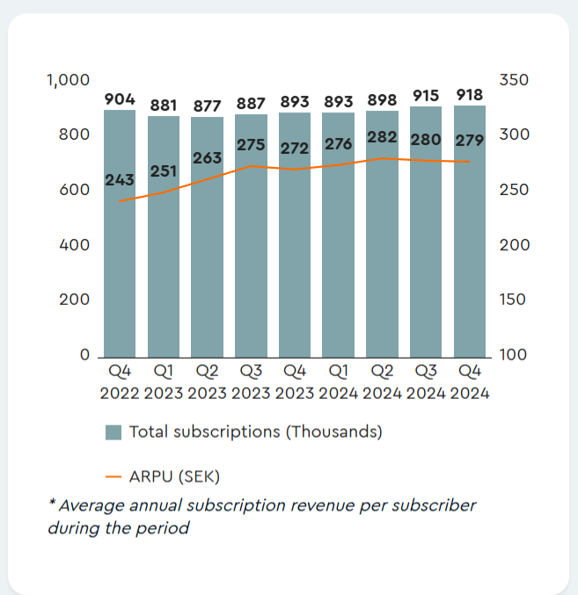
Market
New trend : AI-Powered Sleep Tracking and Analysis
New sleep research emerging countries : China, India
Market growth :
Increasing cases of sleep-related disorder
Rising awareness of sleep’s impact on health
CAGR 13.8% during the forecast period (2025–2033)
Competition :
Sleep Cycle (B2C)

Slide 13
Business Model
B2B Subscription Model:
Companies pay a monthly fee per employee (2CHF–7CHF per employee/month)
Corporate Partnerships:
Collaboration with wellness brands, fitness trackers, and health insurance providers for integrations and sponsorships.
Voucher and rewards sponsored by partnership
In-App Reward Marketplace:
Employees exchange points for gift vouchers

Slide 14
Costs Estimates
Projected Revenue Scenarios (assuming an average of 50 employees per business):
100 businesses (5,000 employees) → 120'000 CHF to 420'000 CHF per year
500 businesses (25,000 employees) → 600'000 CHF to 2'100'000 CHF per year
1,000 businesses (50,000 employees) → 1'200'000 CHF to 4'200'000 CHF per year
5,000 businesses (250,000 employees) → 6'000'000 CHF to 21'000'000 CHF per year
Projected Costs:
Development & Maintenance: 500'000 CHF / year.
Marketing & Sales: 200'000 CHF / year.
Operational Costs: 100'000 CHF / year.
Total : 800'000 CHF / year
First profits : ~ 500 businesses, 25'000 employees

Slide 15
Financing
Seed Funding: Targeting 500'000 CHF for 18 months of developement
Funding Sources:
Angel investors & venture capitalists
Government grants & health tech accelerators
Corporate partnerships
Break-even Point: Estimated with 10,000 users onboarded on 2027

Slide 16
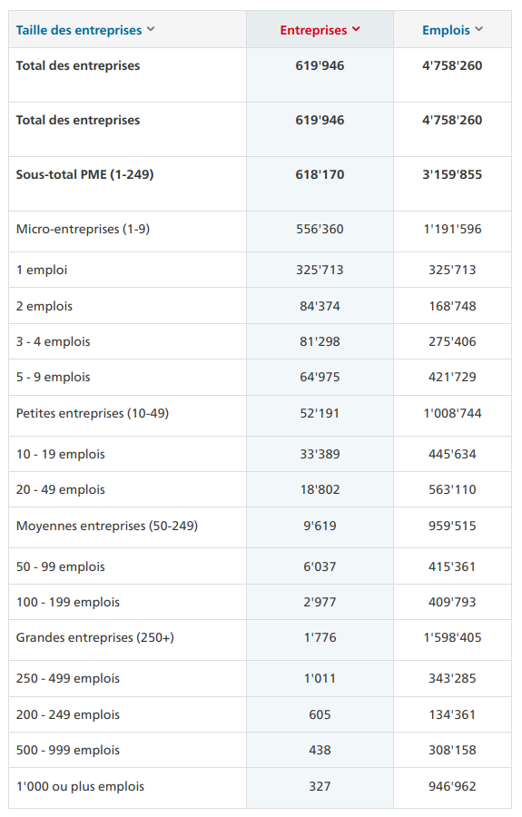
Total Addressable Market
Total companies in switzerland : 619'946
Target companies : SMEs or bigger
Total SMEs or bigger : 11395
10% of the swiss market
1139 companies with more than 50 employees
Incomes per year (2CHF): 1'366'800 CHF
Incomes per year (7CHF): 4'783'800CHF

Slide 17
Evolution Timeline
Commercialize Sleepwell
Intenational expansion
Launch of the developpement
Marketing & Sales launch
20'000 users
80'000 users
2025
2026
2027
2028
2029
18 months
Funding : 500'000
18 months
Benefits: > 480'000
18 months
Benefits: > 1'920'000

Slide 18
Our Team
Yannis Charalambidis – Product Development Lead
Sélien Wicki – Developement & Partnerships
Coralie Beuchat – Development & User Experience
Business and Management expert
Marketing expert

Slide 19
Thank you for your attention
And welcome to SleepWell

Slide 20
https://pmc.ncbi.nlm.nih.gov/articles/PMC5627640/
https://en.wikipedia.org/wiki/Sleep_deprivation
https://straitsresearch.com/report/sleep-tech-market
https://www.touteleurope.eu/economie-et-social/les-entreprises-dans-l-union-europeenne/ (TAM)
https://www.kmu.admin.ch/kmu/fr/home/savoir-pratique/politique-pme-faits-et-chiffres/chiffres-sur-les-pme/entreprises-et-emplois.html (TAM suisse)

